Slide 1
Tools - Photoshop vs Sketch (Day 1)
Viktoras Lava www.viktoraslava.lt

Slide 2
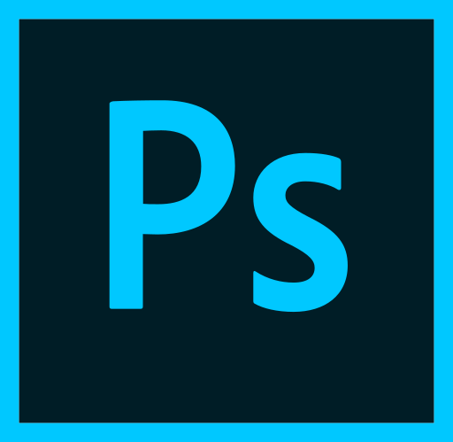
What is Photoshop?
Photoshop was created in 1988. It is imaging and design application for:
Photographs
Websites
Mobile apps
3D artworks
Videos
It was created mainly for photo editing - not web design!

Slide 3

Pricing
Currently, the cheapest Photoshop plan is “Photography” plan. It costs 9.99$ per month and it includes:
Lightroom CC
Lightroom CC classic
Photoshop CC
20 GB of cloud storage
Pricing

Slide 4
Photoshop pros and cons front-end
Pros:
Time-tested
Compatible with Windows and Mac OS
Have plugins
Excellent color management
Excellent photo editing capabilities
Cons:
Heavy (Up to 1GB)
Slow (needs plenty of RAM)
The tool for everyone
Cluttered menu
Poor web-style rendering
No grids

Slide 5

Why Photoshop?
Choose Photoshop if you are graphics professional or planning to become one to accomplish these tasks:
Graphic design and Ilustration
Website design
Painting / Drawing
Photo manipulation

Slide 6
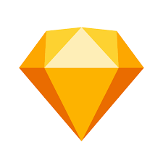
What is Sketch?
Sketch is digital design tool for Mac that was created in 2008. It is used for:
Web design
Mobile app design
Icon design
It was created mainly for designing websites.

Slide 7
Pricing
Currently, sketch costs 99.99$ per year, so it is around 8.33$ per month and it includes:
Mirror app
Sketch cloud
Pricing

Slide 8
Sketch pros and cons for front-end
Pros:
Lightweight (41 MB)
Fast
Focused on websites and interfaces
Tools and values easily translated to CSS
Have built-in GRIDS
Everything is Vector based
Cons:
Only works on Mac OS
Poor color manegement
No photo editing capabilities

Slide 9
Photoshop vs Sketch
Photoshop:
Heavy (Up to 1GB)
Slow (needs plenty of RAM)
The tool for everyone
Poor web-style rendering
No grids
Everything is raster based
Excellent color management
Excellent photo editing capabilities
Sketch:
Lightweight (41 MB)
Fast
Tool for websites and interfaces
Tools and values easily translated to CSS
Have built-in GRIDS
Everything is vector based
Poor color management
No photo editing capabilities

Slide 10

Alternatives
You might be in a case that you can’t use Sketch or using Photoshop is just not practical.
There are 2 good alternatives in this case:
photopea
zeplin

Slide 11
Questions?

